Slide 1

Active Directory User Management: Provisioning and Validation
Standard Operating Procedure for the lab.local Domain
Objective: To demonstrate the end-to-end process of creating a new domain user and verifying network authentication.

Slide 2
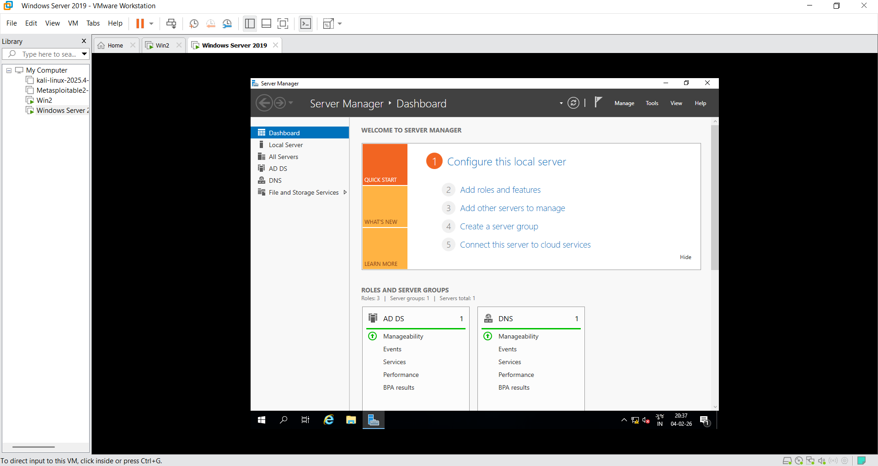
Accessing the Windows Server 2019 Dashboard via Server Manager
Launch Server Manager and navigate to the Tools menu.
Active Directory Users and Computers to manage domain objects.

Slide 3
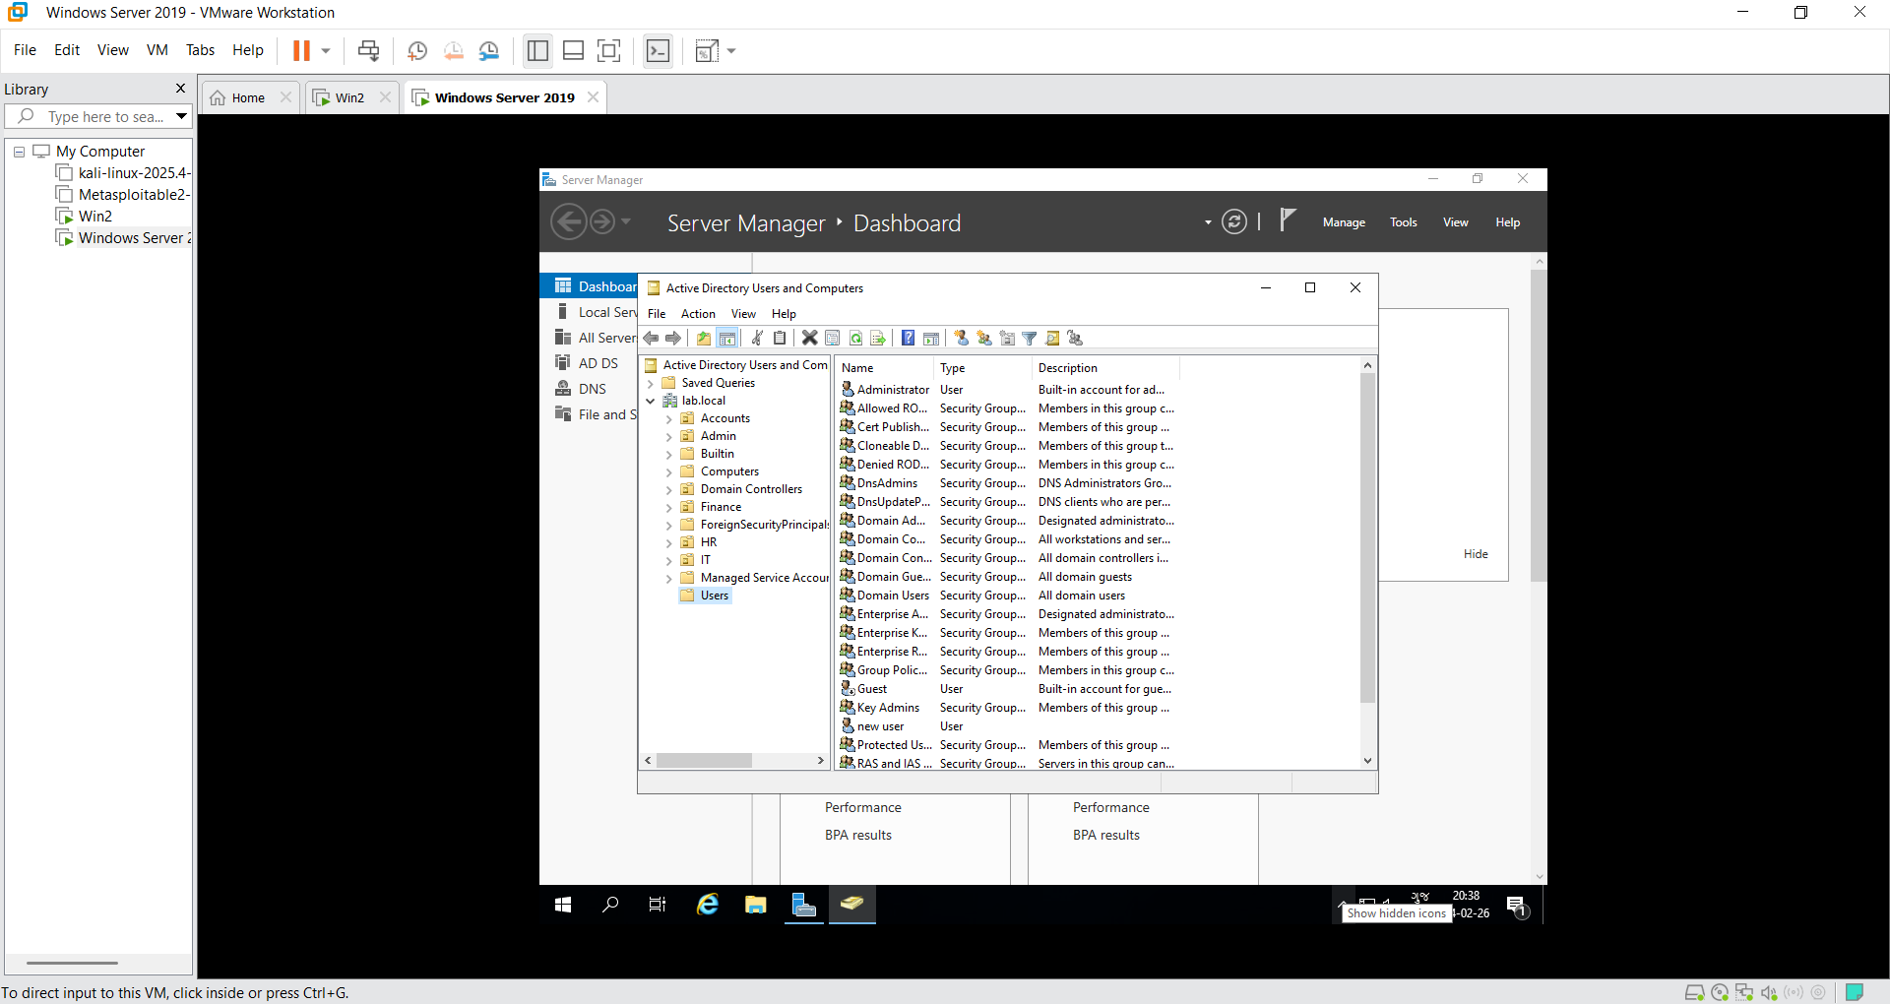
Expand the lab.local domain and select the Users container

Slide 4
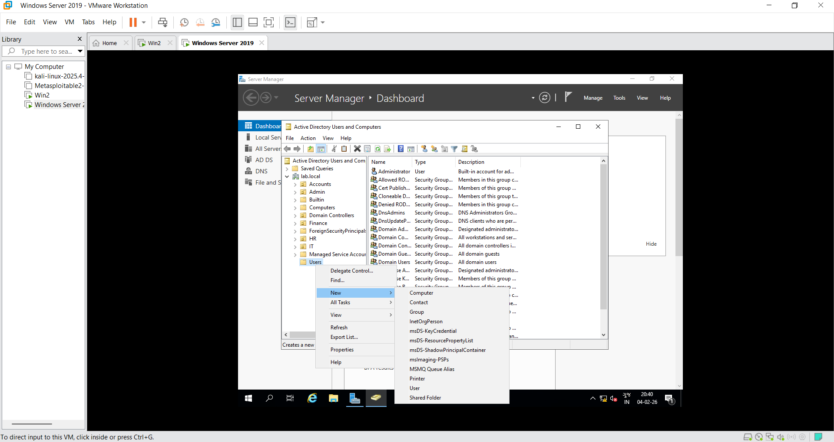
Right-click the container, select New, and then choose User.

Slide 5
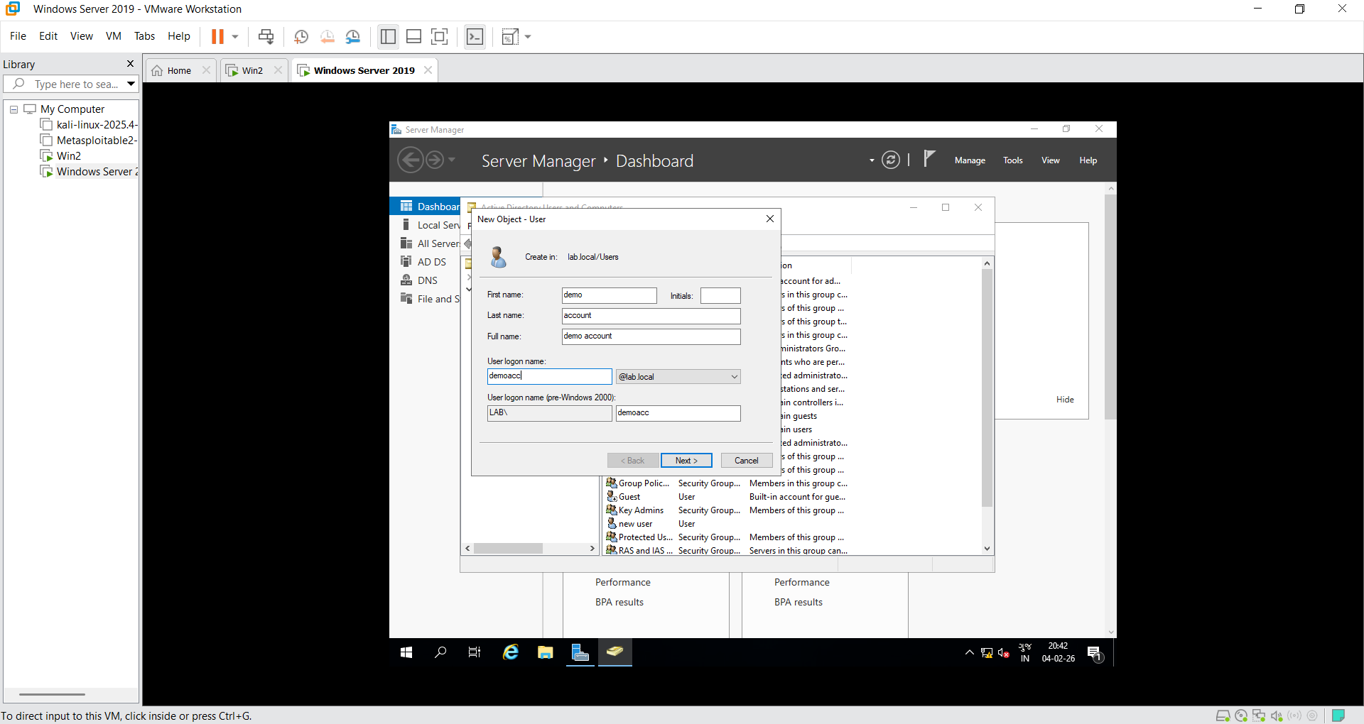
Define the Full Name as "demo account" and set the User Logon Name

Slide 6
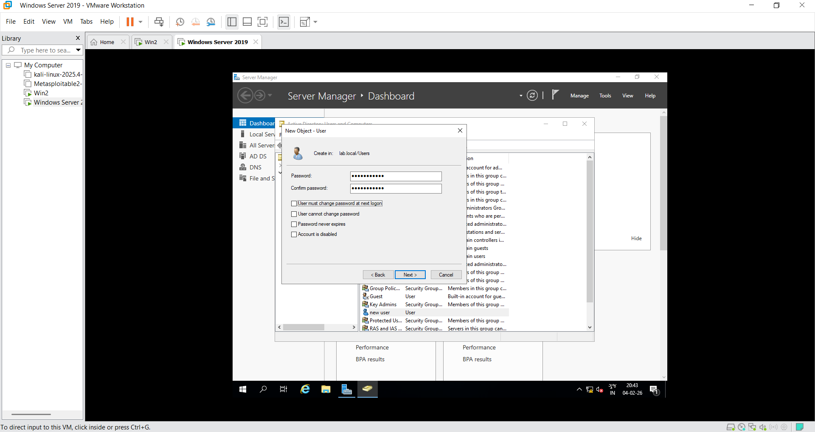
Assign an initial secure password for the account.
Multiple options are available, such as "User must change password at next logon," to maintain security standards.

Slide 7
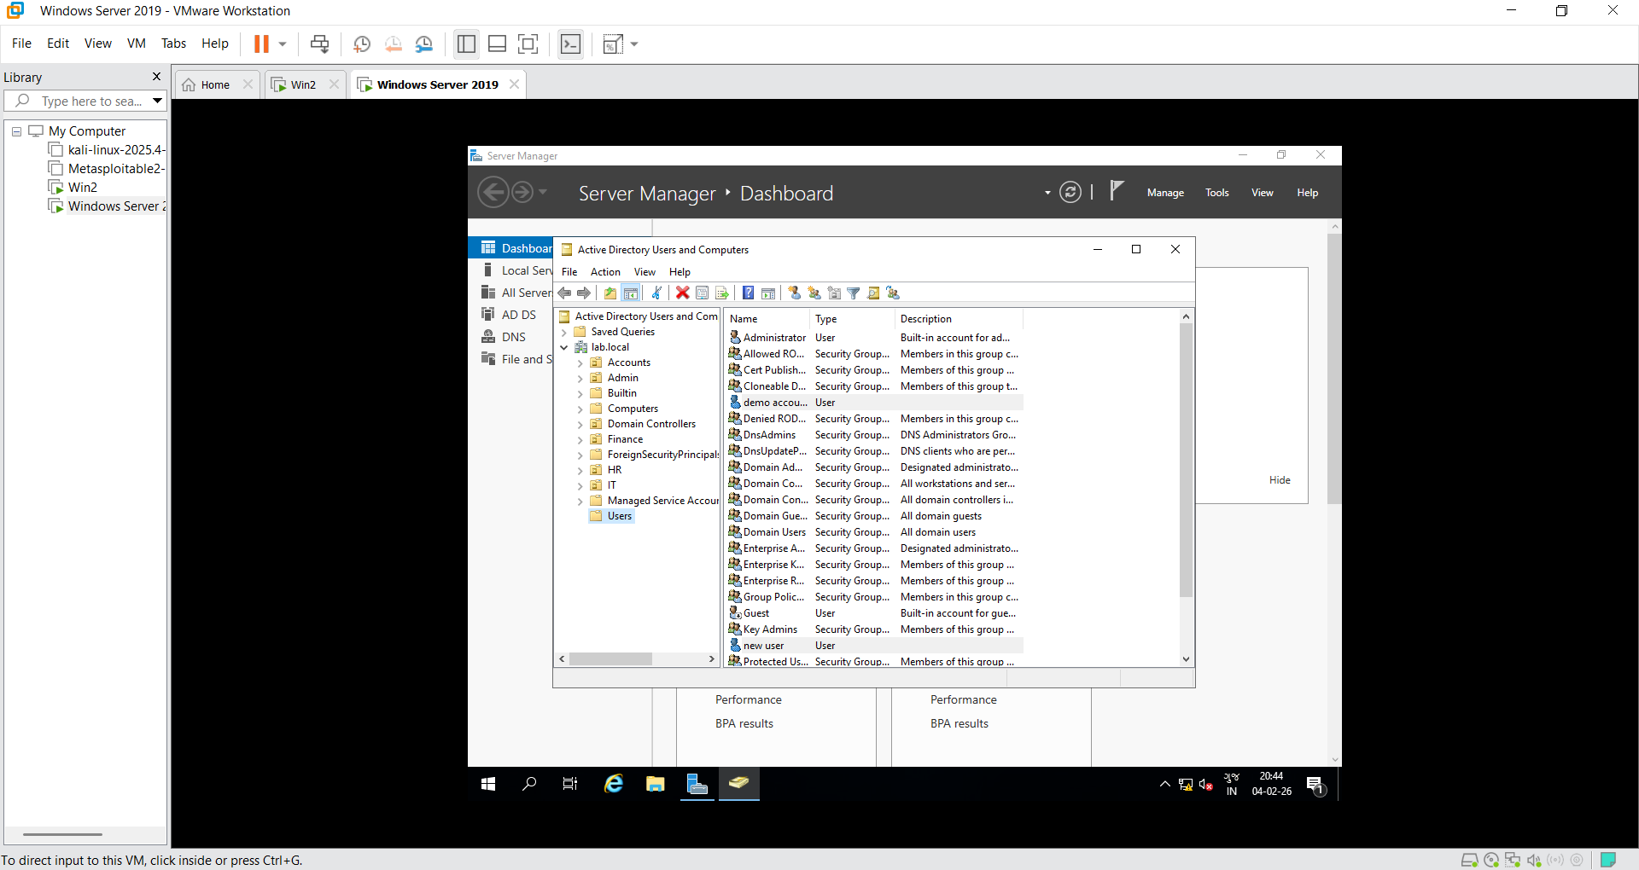
Finalize the wizard to successfully create the account object in the directory.

Slide 8
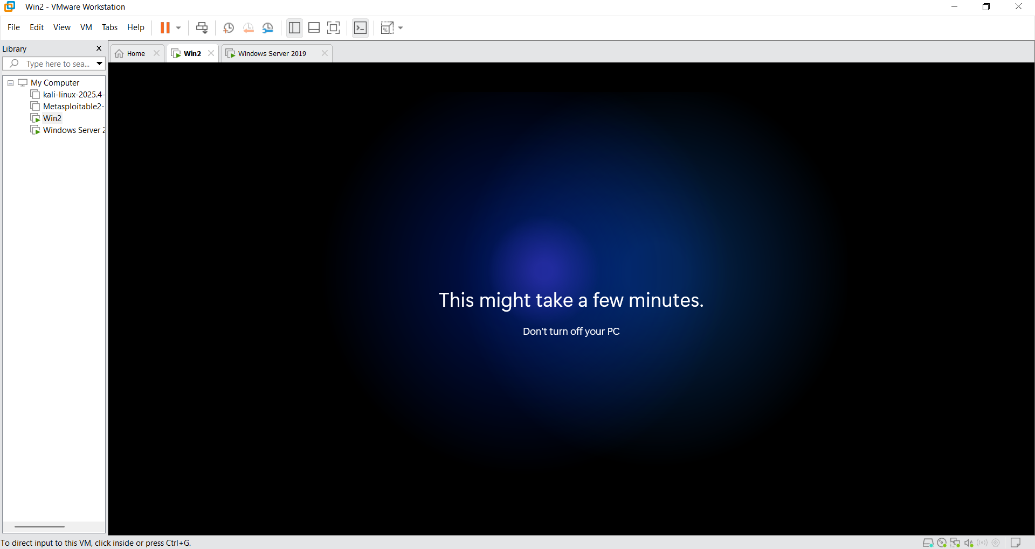
Log in to a domain-joined workstation ( WIN02) using the demoacc credentials.

Slide 9
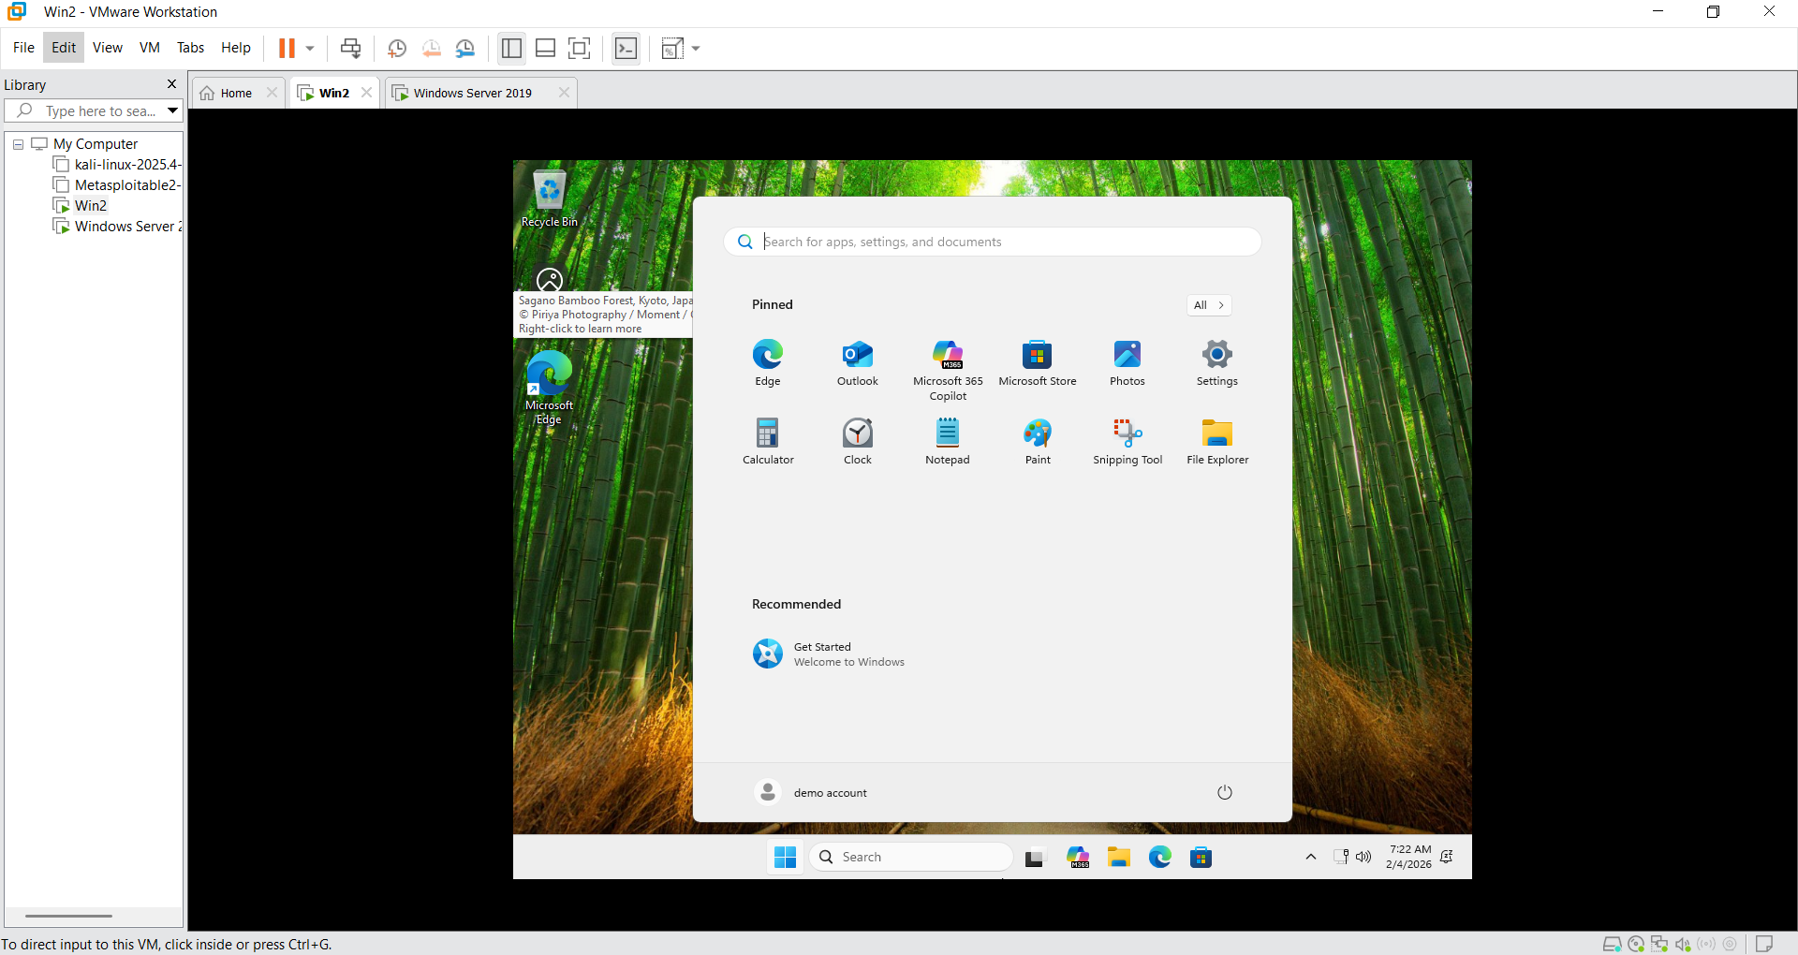
Verify the machine’s membership in the lab.local domain to ensure proper resource access.

Slide 10
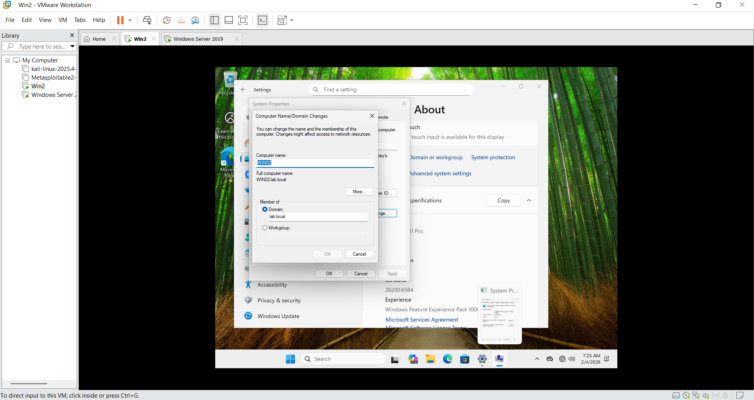
Our user is part of out Domain local.lab

Slide 11
Thank You

